Slide 1
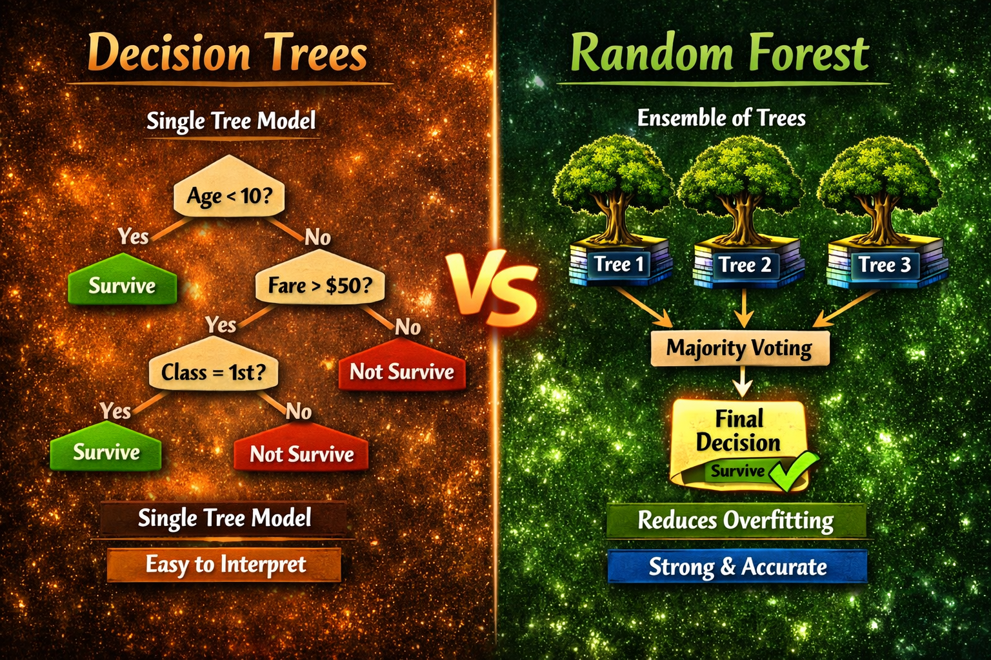
DECISION TREES & RANDOM FOREST
Dr ASHOK GOPALAKRISHNAN
PROFESSOR & SCIENTIST EMERITUS NASA AND UNIVERSITY OF TEXAS @ AUSTIN

Slide 2
DECISION TREES & RANDOM FOREST
A decision tree is a supervised learning algorithm used for classification and regression tasks. It works by recursively splitting a dataset into subsets based on feature values, creating a tree-like structure where each internal node represents a decision rule, and each leaf node represents an outcome.
Key Steps in the Decision Tree Algorithm
1. Splitting the Data
The algorithm starts by selecting the best feature to split the data at each node. The "best" feature is determined using metrics like Information Gain (based on entropy) or Gini Impurity:
Entropy measures the randomness in the dataset. Lower entropy indicates purer subsets.
Information Gain quantifies the reduction in entropy after a split.
Gini Impurity measures the likelihood of incorrect classification if a random sample is chosen.
For example, the formula for Gini Impurity is:
Gini(D) = 1 - Σ (pi)^2
where pi is the probability of class i in dataset D.

Slide 3
DECISION TREES & RANDOM FOREST
2. Recursive Splitting
The dataset is recursively divided based on the selected feature until:
All data in a node belongs to the same class.
No features remain for splitting.
A stopping criterion (e.g., maximum depth or minimum samples per node) is met.
3. Stopping Criteria
To prevent overfitting, the tree stops growing when:
All examples in a node belong to the same class.
No features are left to split.
The tree reaches a predefined depth or minimum number of samples per node.
4. Pruning
Pruning reduces overfitting by simplifying the tree:
Pre-pruning stops tree growth early based on criteria like minimum information gain or maximum depth.
Post-pruning trims branches from a fully grown tree by evaluating their impact on performance.
5. Prediction
Once the tree is built, predictions are made by traversing the tree from the root to a leaf node based on the feature values of the input data.

Slide 4
DECISION TREES & RANDOM FOREST
Advantages:
Easy to interpret and visualize.
Handles both categorical and continuous data.
Requires minimal data preprocessing.
Limitations:
Prone to overfitting, especially with noisy data.
Can create biased trees if some classes dominate the dataset.
Computationally expensive for large datasets with many features.
Use Cases
Decision trees are widely used in:
Classification tasks (e.g., spam detection, medical diagnosis).
Regression tasks (e.g., predicting house prices).
Feature selection and rule-based modeling.

Slide 5
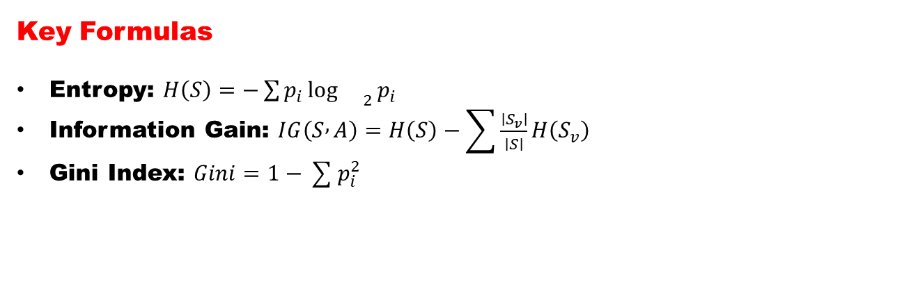
DECISION TREES & RANDOM FOREST
Decision Tree — Deep Dive
🔹 Intuition
Mimics human decision‑making: “If Age < 10 → Survive.”
Each internal node represents a test on a feature; each leaf represents an outcome.
🔹 Algorithm Steps
Select best feature using a criterion:
Entropy and Information Gain (ID3 algorithm)
Gini Index (CART algorithm)
Split data recursively until stopping criteria are met.
Prune the tree to avoid overfitting.
Key Formulas
Entropy: $H\left(S\right)=−\sum{p_{i}}{\log{}}_{2}p_{i}$
Information Gain: $IG\left(S , A\right)=H\left(S\right)−\sum{\frac{∣S_{v}∣}{∣S∣}}H\left(S_{v}\right)$
Gini Index: $Gini=1−\sum{p_{i}^{2}}$

Slide 6
DECISION TREES & RANDOM FOREST
Advantages
Easy to interpret and visualize.
Handles both numerical and categorical data.
Limitations
Overfits easily.
Sensitive to small data changes.
Random Forest — Deep Dive
Concept
Ensemble of multiple decision trees.
Uses bagging (bootstrap aggregation) and feature randomness to reduce variance.
Algorithm Steps
Draw multiple bootstrap samples from the dataset.
Train a decision tree on each sample using random subsets of features.
Aggregate predictions:
Majority vote for classification.
Average for regression.

Slide 7
DECISION TREES & RANDOM FOREST
Mathematical Insight
Reduces variance by averaging uncorrelated models.
Each tree contributes a weak learner; together they form a strong learner.
Advantages
High accuracy and robustness.
Handles missing data and large feature spaces.
Provides feature importance ranking.
Limitations
Less interpretable.
Computationally heavier.
Applications
Credit scoring, medical diagnosis, spam detection, stock prediction, and image classification.
Random Forest is widely used in Kaggle competitions for tabular data.
“A Decision Tree is one expert; a Random Forest is a panel of experts voting together.”

Slide 8
DECISION TREES & RANDOM FOREST
from sklearn.tree import DecisionTreeClassifier
from sklearn import tree
import pandas as pd
# Example dataset
data = pd.read_csv("titanic.csv")
X = data[['Age', 'Fare', 'Pclass']]
y = data['Survived']
X.fillna(X.mean(), inplace=True)
# ID3-like (criterion='entropy')
id3_tree = DecisionTreeClassifier(criterion='entropy', max_depth=4)
id3_tree.fit(X, y)
# CART-like (criterion='gini')
cart_tree = DecisionTreeClassifier(criterion='gini', max_depth=4)
cart_tree.fit(X, y)
print("ID3 Accuracy:", id3_tree.score(X, y))
print("CART Accuracy:", cart_tree.score(X, y))
Python Demonstration Snippet

Slide 9
DECISION TREES & RANDOM FOREST
The ID3 algorithm constructs a decision tree by selecting the attribute that best splits the dataset at each step. It uses Entropy and Information Gain to measure impurity and determine the most informative feature for splitting the data.
Step 1: Initialize Root Node
The entire dataset is placed at the root node containing all training samples.
Step 2: Calculate Entropy
Entropy measures the amount of randomness or impurity in a dataset. If all data points belong to the same class, entropy is 0 (pure node). If the data is evenly distributed among classes, entropy is higher, indicating more disorder.
Entropy in Decision Trees
Definition: Entropy is a measure of impurity or disorder in a dataset. It quantifies how mixed the classes are within a subset of data.
In simple terms: Entropy tells us how uncertain we are about the outcome.

Slide 10
DECISION TREES & RANDOM FOREST
Interpretation
Entropy Value | Meaning
0 | Perfectly pure (all samples belong to one class)
1 | Maximum disorder (equal mix of classes)
Example: If 100 passengers are all survivors → Entropy = 0 (pure). If 50 survived and 50 didn’t → Entropy = 1 (maximum uncertainty).
“Entropy is like confusion in a classroom — if everyone agrees on the answer, confusion is zero. If half say ‘yes’ and half say ‘no,’ confusion is maximum. Decision Trees aim to reduce that confusion step by step.”

Slide 11
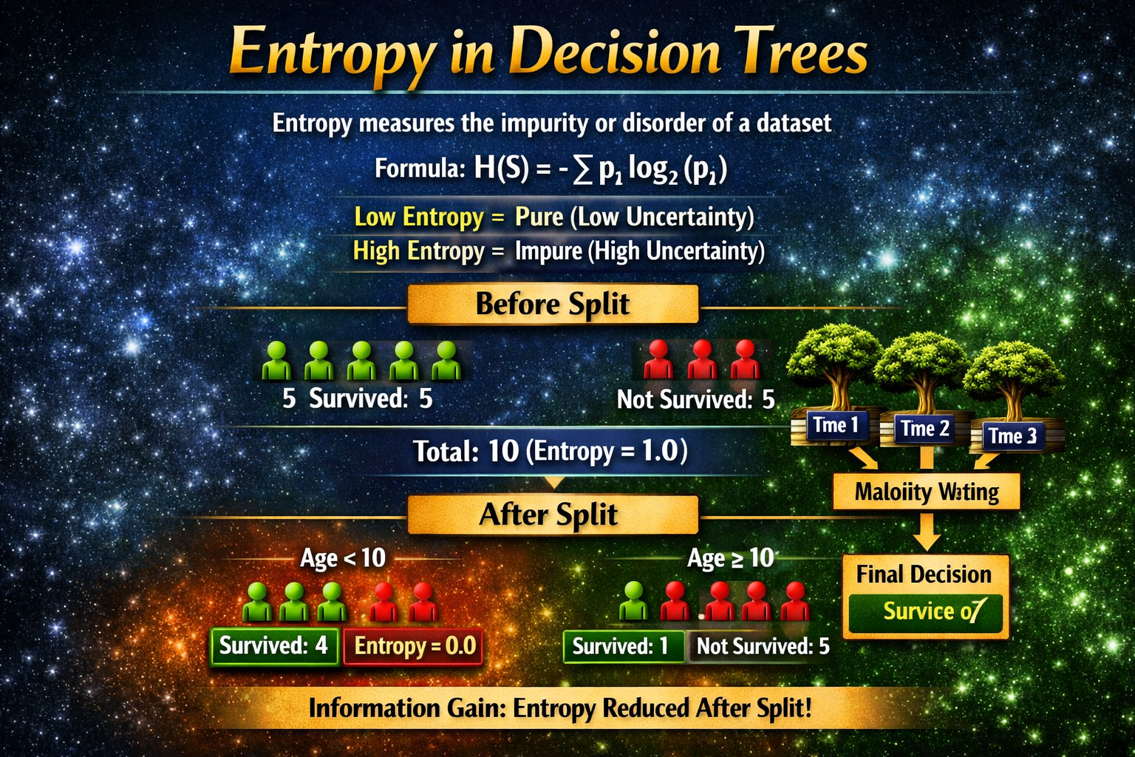
DECISION TREES & RANDOM FOREST
“Entropy tells us how confused the data is. When we split smartly, confusion drops — that’s information gain. A good decision tree keeps asking questions that make the data purer each time.”

Slide 12
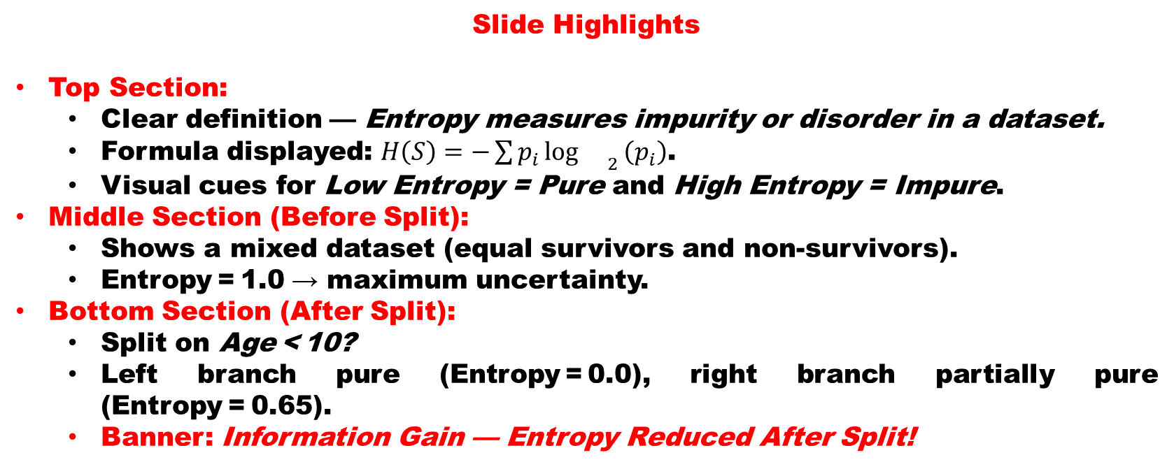
DECISION TREES & RANDOM FOREST
Slide Highlights
Top Section:
Clear definition — Entropy measures impurity or disorder in a dataset.
Formula displayed: $H\left(S\right)=−\sum{p_{i}}{\log{}}_{2}\left(p_{i}\right)$.
Visual cues for Low Entropy = Pure and High Entropy = Impure.
Middle Section (Before Split):
Shows a mixed dataset (equal survivors and non‑survivors).
Entropy = 1.0 → maximum uncertainty.
Bottom Section (After Split):
Split on Age < 10?
Left branch pure (Entropy = 0.0), right branch partially pure (Entropy = 0.65).
Banner: Information Gain — Entropy Reduced After Split!

Slide 13
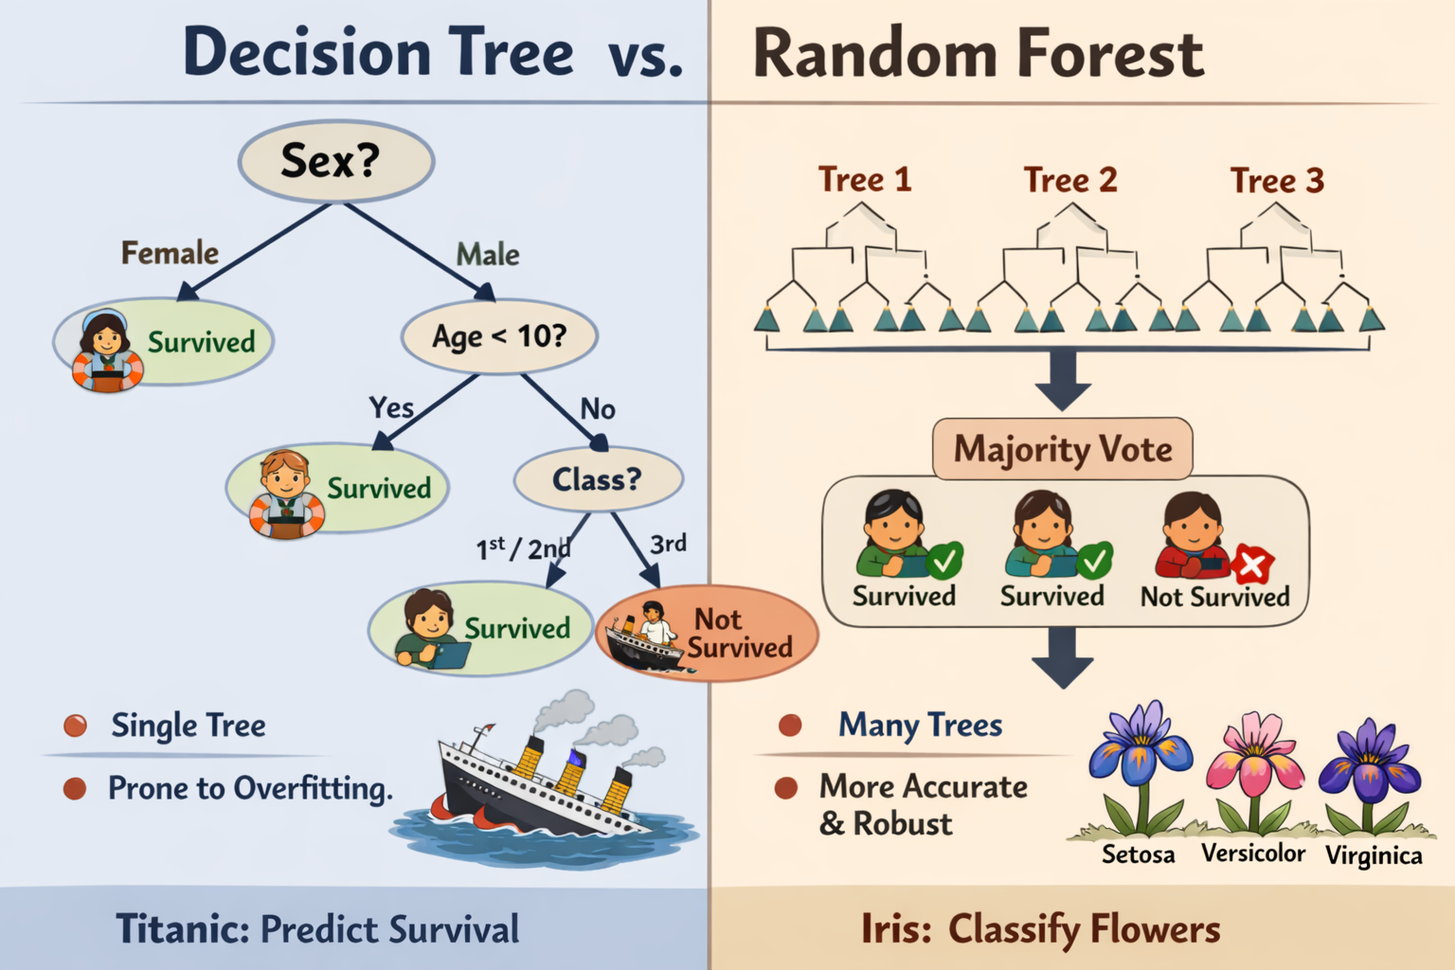
DECISION TREES & RANDOM FOREST
You need to grasp the difference between a single tree’s logic and the ensemble’s majority vote.
Left side: Decision Tree — intuitive, but prone to overfitting.
Right side: Random Forest — ensemble of many trees, more accurate and robust.
Bottom panels: Titanic (social science context) vs. Iris (biology context).
Bottom panels: Titanic (social science context) vs. Iris (biology context).

Slide 14
DECISION TREES & RANDOM FOREST
Classroom Activity: “Build Your Own Forest”
Part 1 – Decision Tree Challenge
Objective: Students manually create a mini decision tree.
Give each group a small dataset (e.g., Titanic passengers or Iris flowers).
Ask them to choose one feature to split on (Sex, Age, or Petal Length).
They draw branches and predict outcomes.
Discuss: What happens if the tree goes too deep? → Introduce overfitting.
Part 2 – Random Forest Simulation
Objective: Experience ensemble voting.
Each group builds a slightly different tree (using different features).
Combine all group predictions for one test case.
Majority vote decides the final outcome.
Discuss: How does combining trees improve reliability?
Part 3 – Reflection
Prompt students:
“If one tree makes a mistake, how does the forest correct it?”
Encourage them to connect this to teamwork — multiple perspectives leading to better decisions.

Slide 15
DECISION TREES & RANDOM FOREST
Pruning: Getting an Optimal Decision tree
Pruning is a process of deleting the unnecessary nodes from a tree in order to get the optimal decision tree.
Points to remember:
A leaf node is the one that has no entropy, or when the entropy is zero. No further splitting is done on a leaf node.
Only the branch that needs further splitting, i.e. when the entropy > 0 (when there’s impurity) needs to undergo this splitting process.
ID3 algorithm uses entropy to calculate the homogeneity of a sample. If the sample is completely homogeneous the entropy is zero and if the sample is an equally divided it has entropy of one.
Decision trees are upside down which means the root is at the top and then this root is split into various several nodes. Decision trees are nothing but a bunch of if-else statements in layman terms. It checks if the condition is true and if it is then it goes to the next node attached to that decision.

Slide 16
DECISION TREES & RANDOM FOREST
Why Data Cleansing Matters Before Trees
Decision Trees are sensitive to noisy or missing data. If the Titanic dataset had inconsistent entries (e.g., “male” vs. “M”), or missing ages, the splits would be unreliable.
Unclean data → misleading splits.
Clean data → meaningful branches.
Decision Tree in Cleansing
Detecting Outliers: A tree split that isolates a single record (e.g., Fare = 512) signals an outlier.
Handling Missing Values: Trees can either:
Ignore rows with missing values.
Use surrogate splits (alternative features when primary is missing).
Feature Importance: Trees highlight which features matter most (Sex, Age, Class in Titanic). This guides which variables to clean carefully.

Slide 17
DECISION TREES & RANDOM FOREST
Why Data Cleansing Matters Before Trees
Random Forest in Cleansing
Robustness to Noise: Because forests average across many trees, they reduce the impact of dirty data.
Feature Selection Aid: Random Forest feature importance helps identify irrelevant or redundant variables — useful in cleansing.
Imputation Support: Forests can predict missing values by treating them as targets in auxiliary models.
“Before planting a tree, we clear the ground. Similarly, before building a Decision Tree, we cleanse the dataset.”

Slide 18
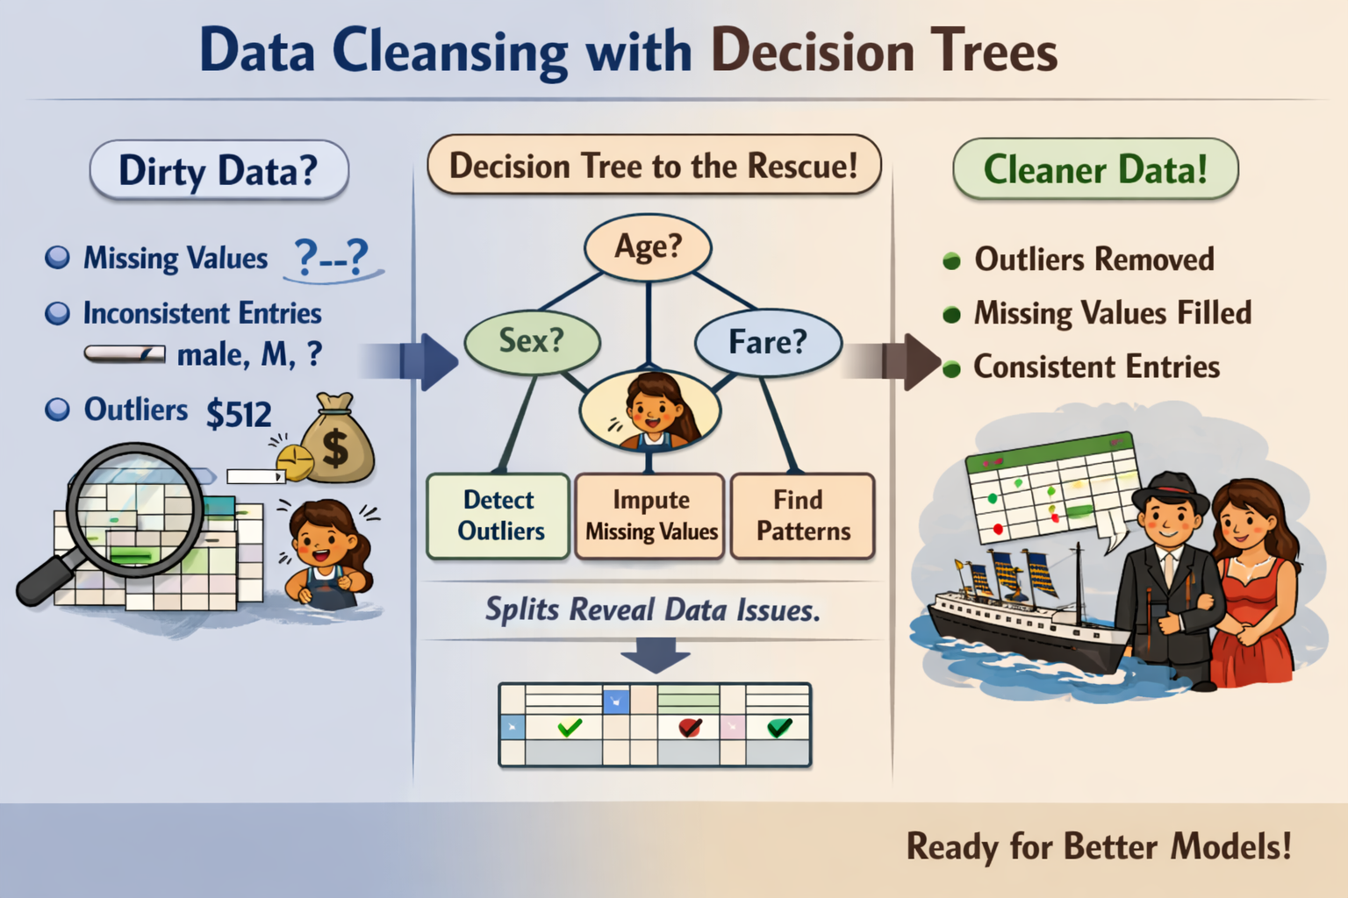
DECISION TREES & RANDOM FOREST
Dirty Data? → Missing values, inconsistent entries, outliers.
Decision Tree to the Rescue! → Splits reveal issues, detect outliers, impute missing values, find patterns.
Cleaner Data! → Outliers removed, missing values filled, consistent entries → ready for better models.

Slide 19
DECISION TREES & RANDOM FOREST
Worksheet: Data Cleansing with Decision Trees
Section 1 – Spot the Dirty Data
Task: Identify issues in the sample dataset below.
Passenger | Sex | Age | Fare | Survived
1 | male | ? | 512 | 0
2 | Female | 25 | 71 | 1
3 | M | 8 | 21 | 1
4 | male | 35 | ? | 0
Reflection: What kinds of problems do you see? (Missing values, inconsistent entries, outliers)

Slide 20
DECISION TREES & RANDOM FOREST
Worksheet: Data Cleansing with Decision Trees
Section 2 – Tree‑Based Cleansing
Task: Use a Decision Tree to guide corrections.
Split on Sex, Age, and Fare.
Predict missing values or flag outliers.
Feature | Split Condition | Cleansing Action
Sex | male vs Female | Standardize labels
Age | < 10 | Impute missing ages
Fare | > 300 | Flag as outlier
Reflection: How do tree splits help reveal data issues?

Slide 21
DECISION TREES & RANDOM FOREST
Worksheet: Data Cleansing with Decision Trees
Section 3 – Random Forest Robustness
Task: Discuss how multiple trees handle noisy data.
Each tree uses different subsets of features.
Majority vote reduces the effect of errors.
Reflection: Why is ensemble learning more reliable for messy datasets?
Section 4 – Summary
Decision Tree: Detects patterns and anomalies.
Random Forest: Smooths out noise and improves accuracy.
Outcome: Cleaner, more trustworthy data for modeling.

Slide 22
DECISION TREES & RANDOM FOREST
from sklearn.tree import DecisionTreeClassifier, plot_tree
from sklearn.model_selection import train_test_split
from sklearn.metrics import accuracy_score
import pandas as pd
import matplotlib.pyplot as plt
# Load Titanic dataset (preprocessed)
data = pd.read_csv("titanic_clean.csv")
X = data.drop("Survived", axis=1)
y = data["Survived"]
# Split data
X_train, X_test, y_train, y_test = train_test_split(X, y, test_size=0.2, random_state=42)
# Train Decision Tree
dt = DecisionTreeClassifier(max_depth=3, criterion='gini', random_state=42)
dt.fit(X_train, y_train)
# Evaluate
print("Decision Tree Accuracy:", accuracy_score(y_test, dt.predict(X_test)))
# Visualize
plt.figure(figsize=(12,6))
plot_tree(dt, feature_names=X.columns, class_names=['Not Survived', 'Survived'], filled=True)
plt.show()
Decision Tree for Classification (Titanic Example)

Slide 23
DECISION TREES & RANDOM FOREST
Decision Tree for Classification (Titanic Example)
Random Forest for Ensemble Learning
from sklearn.ensemble import RandomForestClassifier
# Train Random Forest
rf = RandomForestClassifier(n_estimators=100, max_depth=5, random_state=42)
rf.fit(X_train, y_train)
# Evaluate
print("Random Forest Accuracy:", accuracy_score(y_test, rf.predict(X_test)))
# Feature Importance
importances = pd.Series(rf.feature_importances_, index=X.columns)
print(importances.sort_values(ascending=False))

Slide 24
DECISION TREES & RANDOM FOREST
Decision Tree for Classification (Titanic Example)
Decision Tree for Data Cleansing
import numpy as np
# Detect missing values
missing_summary = data.isnull().sum()
print("Missing Values:\n", missing_summary)
# Detect outliers using IQR
Q1 = data['Fare'].quantile(0.25)
Q3 = data['Fare'].quantile(0.75)
IQR = Q3 - Q1
outliers = data[(data['Fare'] < (Q1 - 1.5 * IQR)) | (data['Fare'] > (Q3 + 1.5 * IQR))]
print("Outliers detected:\n", outliers[['PassengerId', 'Fare']])

Slide 25
DECISION TREES & RANDOM FOREST
Today’s session explored how Decision Trees and Random Forests serve as powerful tools for understanding and improving data quality. We began by revisiting the Titanic dataset, where each split in a tree revealed meaningful patterns — gender, age, and class — that shaped survival outcomes. This intuitive structure helped us see how decision trees mimic human reasoning, turning raw data into clear, interpretable rules.
We then extended the concept to Random Forests, showing how multiple trees working together overcome the limitations of a single model. Through ensemble learning, the forest reduces noise, balances bias and variance, and delivers more reliable predictions. Students saw how collective wisdom — many perspectives — leads to stronger decisions, both in data science and in life.
Finally, we connected these models to data cleansing, emphasizing that clean data is the foundation of trustworthy analytics. Decision Trees can detect outliers, impute missing values, and highlight inconsistencies, while Random Forests smooth out errors through aggregation. The message was clear: before building models, we must first nurture the data itself.
In essence, today’s lecture bridged theory and practice — from understanding how trees learn to how they help us clean and refine datasets. As we move forward, let’s remember that every branch and leaf in a tree represents a decision shaped by data integrity, and that the forest’s strength lies in diversity and collaboration.

Slide 26


